Slide 1
CAR SALES ANALYSIS EXPLORATORY DATA ANALYSIS
Subtitle: Business Insights & Recommendations
Tools Used: Power BI, Excel
Prepared by: Sam Ebanezer

Slide 2
AGENDA
01
06
Executive Summary
EDA Results
02
07
Business Problem Overview
Data Preprocessing
03
08
Solution Approach
Conclusions and Recommendations
04
Data Dictionary
05
Solution Methodology

Slide 3
EXECUTIVE SUMMARY
Overview:
Our startup leverages data-driven analytics to optimize car sales performance, improve revenue generation, and enhance dealer decision-making.
Key Insights:
  Total Revenue exceeds ₹275M, driven mainly by mid-range vehicles
  Automatic transmission cars generate higher revenue than manual
  SUVs and Sedans dominate customer preference
  Sales are concentrated among few top-performing brands and dealers
  Male customers contribute ~79% of total revenue
Key Recommendations:
  Focus inventory on high-performing models & body styles
  Strengthen partnerships with top dealers
  Increase promotions during high-revenue months
  Introduce targeted campaigns for underrepresented customer segments

Slide 4
analytical view to:
  Understand sales performance across regions
  Identify top-performing brands and models
  Analyze customer purchasing behavior
  Detect seasonal sales trends
Business Need:
  Data-driven decision making
  Improve revenue & customer targeting
  Optimize inventory and pricing strategy
Problem Statement-
How can car sales businesses use data analytics to:
  Maximize revenue?
  Identify top-performing products and dealers?
  Understand customer behavior?
BUSINESS PROBLEM OVERVIEW

Slide 5
SOLUTION APPROACH
Approach Followed
Tool Used
  Collected historical car sales data
  Cleaned and transformed the dataset
  Performed Exploratory Data Analysis (EDA)
  Built interactive dashboards in Power BI
  Extracted business insights and recommendations
  Power BI
  Excel
  Data Visualization Techniques

Slide 6
Description | Column Name
Car manufacturer | Company
Vehicle model | Model
Selling price of the car | Price
SUV, Sedan, Hatchback, etc. | Body_Style
Automatic / Manual | Transmission
Selling dealer | Dealer_Name
Dealer location | Dealer_Region
Customer gender | Gender
Customer income | Annual_Income
Sales transaction date | Date
Budget / Mid / Premium | Price_Category
DATA DICTIONARY

Slide 7

SOLUTION METHODOLOGY
Methodology Steps
Analysis Type
  Data Understanding
  Data Cleaning & Validation
  Exploratory Data Analysis (EDA)
  Dashboard Creation
  Insight Generation
  Descriptive Analytics
  Diagnostic Analytics

Slide 8
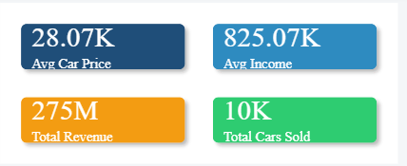
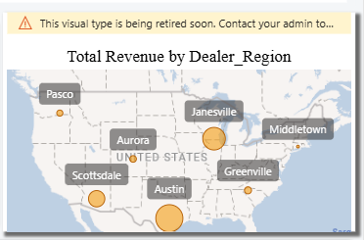
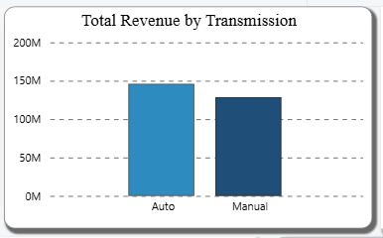
EDA RESULTS – REVENUE ANALYSIS
Insights
Total Revenue KPI Card->
  Automatic cars outperform manual cars in revenue
  Certain regions generate significantly higher sales
  Clear geographical sales concentration observed
<-Total Revenue by Dealer Region (Map)
Total Revenue by Transmission (Bar Chart)->

Slide 9
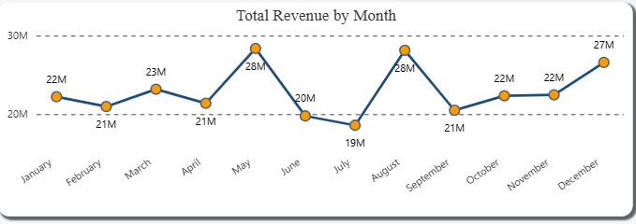
EDA RESULTS – TIME-BASED ANALYSIS
Insights
Total Revenue by Month (Line Chart)
  Revenue peaks in May and August
  Sales dip observed in July
  Seasonal trends affect customer purchasing behavior
Suggestions
  Promotions & Discounts
  Flexible EMI Options

Slide 10
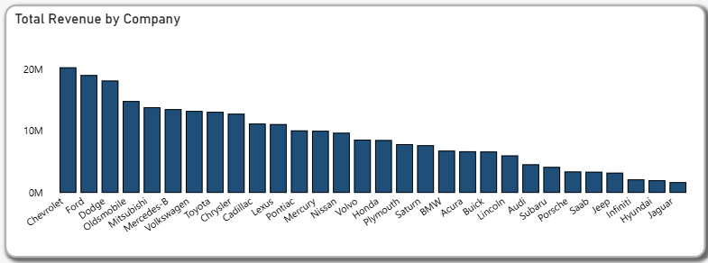
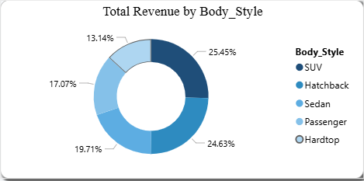
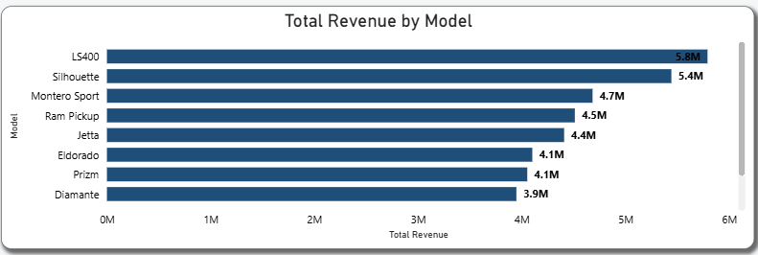
EDA RESULTS – PRODUCT ANALYSIS
Revenue by Company (Bar Chart)
Revenue by Body Style (Donut Chart)
Revenue by Model (Horizontal Bar Chart)
Insights
  Chevrolet and Ford lead in revenue
  Models like LS400 and Silhouette are top performers
  SUVs and Sedans contribute maximum revenue

Slide 11
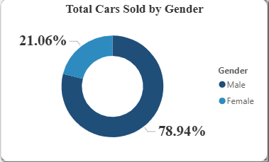
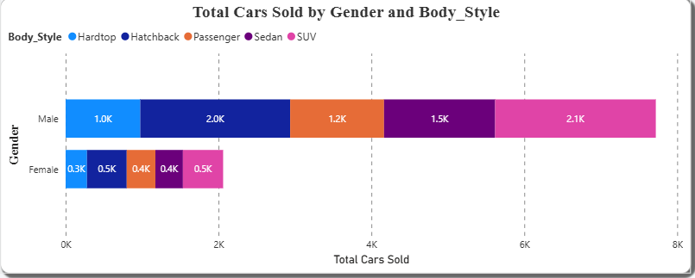
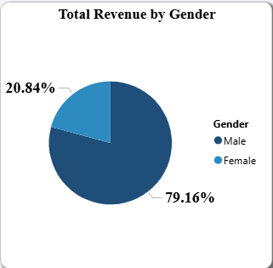
EDA RESULTS – CUSTOMER ANALYSIS
Cars Sold by Gender
Cars Sold by Gender & Body Style
Revenue by Gender
Insights
  Male customers dominate sales and revenue
  Females prefer balanced body styles
  Gender-based marketing opportunity exists

Slide 12
DATA PREPROCESSING
Data Cleaning Steps
Outcome
  Removed duplicate records
  Handled missing values
  Standardized category names
  Converted date fields
  Created calculated measures (Revenue, KPIs)
  Clean and analysis-ready dataset
  Improved data accuracy and consistency

Slide 13

CONCLUSIONS AND RECOMMENDATIONS
Conclusions
  Automatic, mid-range SUVs drive the business
  Strong regional and seasonal sales patterns exist
  Brand and model performance varies significantly
  Customer demographics strongly influence revenue
Recommendations
  Focus inventory on high-demand segments
  Expand operations in high-revenue regions
  Introduce gender-focused marketing strategies
  Use seasonal insights for promotional planning

Slide 14
THANK YOU

